Slide 1
Assembly of a shaft supported by three bearings
Team 32

Slide 2
Hanan Khamis Ali | 19015617
Mohamed Ismael Hassan | 19017492
Mariam Sheriff Mostafa Shahein | 19016635
Gehad Essam Mahmoud Zayd (team leader - 01152865104) | 19015553
Omar Mohie Eldeen Ahmed | 19016096
Abdallah Saed Nasr Mehanna | 19015950
Omar Mohamed Atia Mohamed | 19016094
Omar Gamal Abd Elhamed | 19016061
Nourhan Khaled Saad Mohamed | 19016815
Ahmed Eid Abd Elhafez | 19015298
15
17
23
17
16
21
13
21
14
15

Slide 3
Definition
Bearings are "parts that assist objects' rotation". They support the shaft that rotates inside the machinery.

Slide 4
Usage
Reduce friction and make rotation more smooth
Protect the part that supports the rotation, and maintain the correct position for the rotating shaft

Slide 5
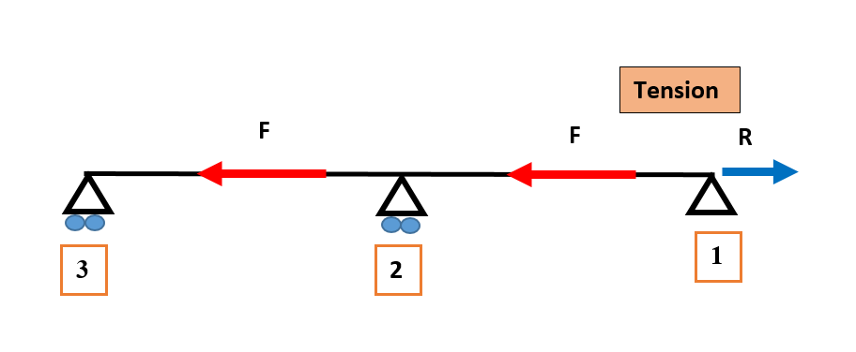
Bearing selection

Slide 6
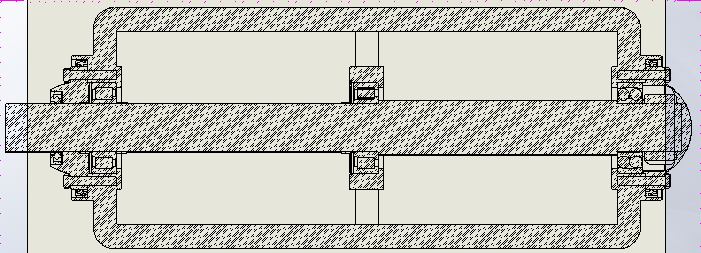
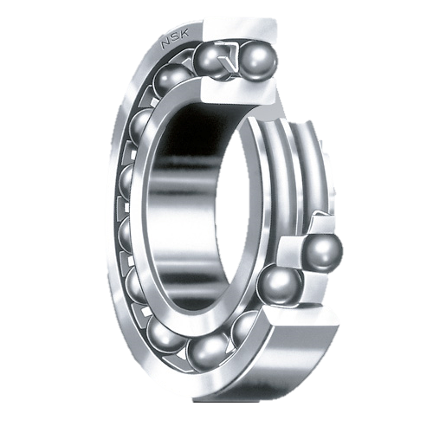
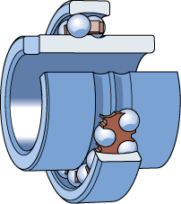
Bearing selection
1 Bearing

Slide 7
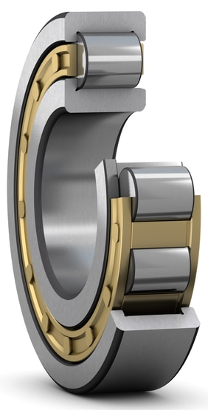
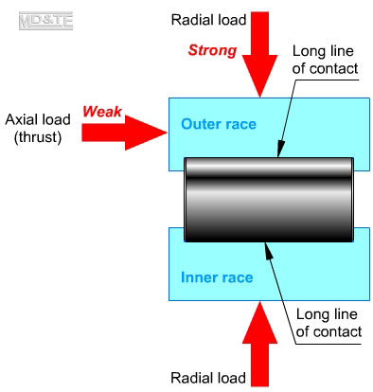
Bearing selection
2,3 Bearing

Slide 8
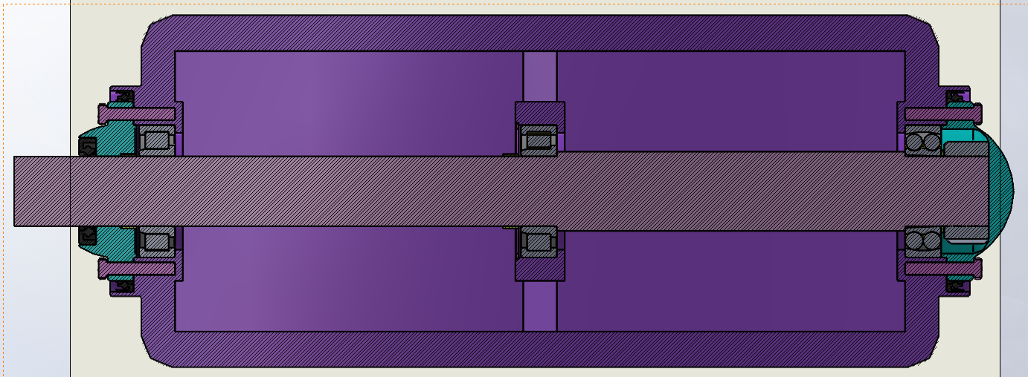
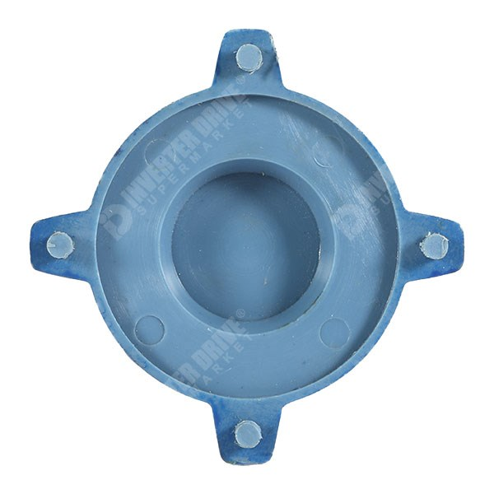

Mounting (outer ring)
cover

Slide 9
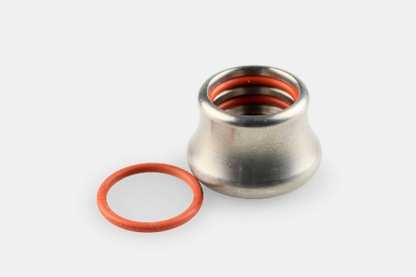
Mounting (middle bearing)
Inner O-ring

Slide 10
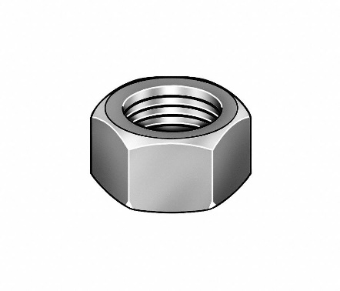
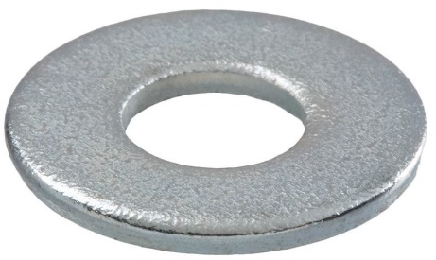
Mounting (inner ring right bearing)
Nut
washer

Slide 11
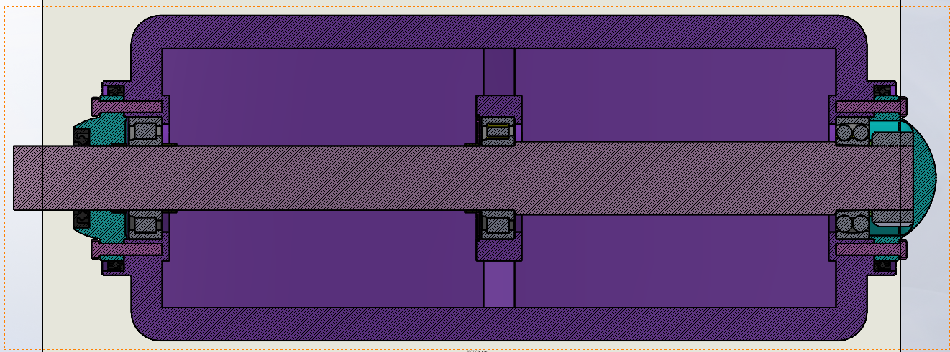
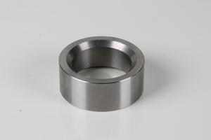
Mounting (middle bearing)
Spacer

Slide 12
Mounting (left bearing)
Spacer

Slide 13
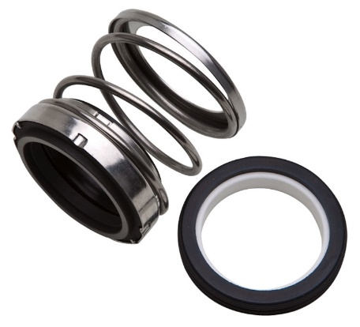
Seal
Seal

Slide 14
Drawing

Slide 15

Solid work animation

Slide 16


Slide 17
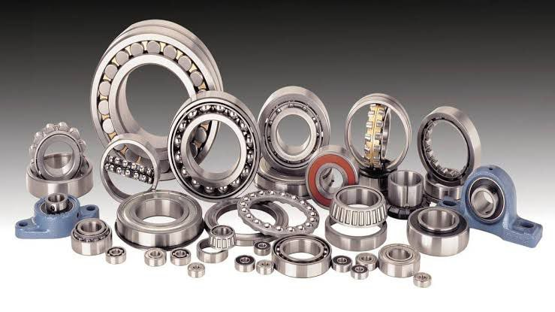
Difference types of bearing materials
Carbon Steel Bearings
Chrome Steel Bearings
Stainless Steel Bearings
Ceramic Bearings
Polymer Plastic Bearings
Hybrid Bearings
All of these types have many uses and multiple applications, but we will talk about Stainless Steel Bearings

Slide 18
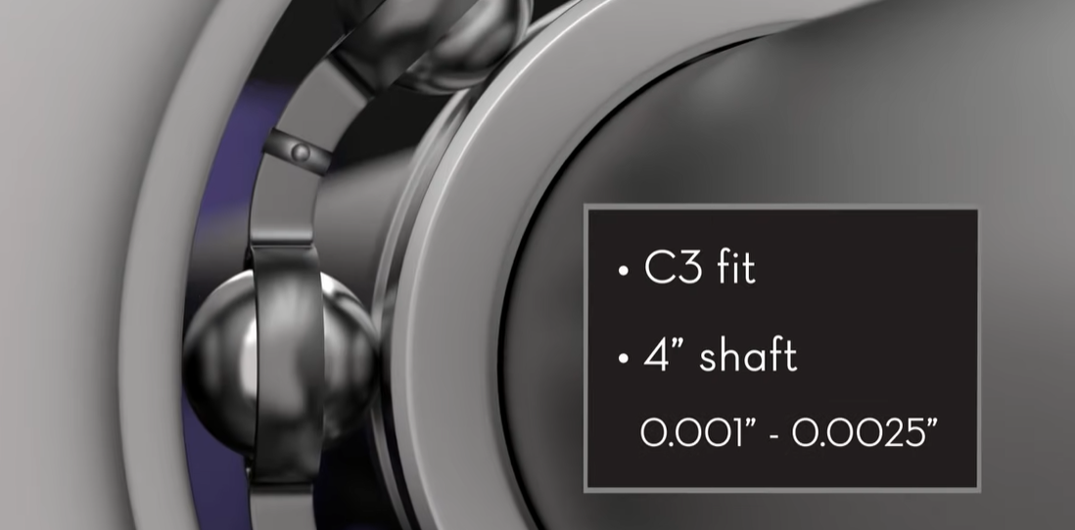
Clearance
Clearance between the housing and cover
Clearance between bearing and shaft

Slide 19
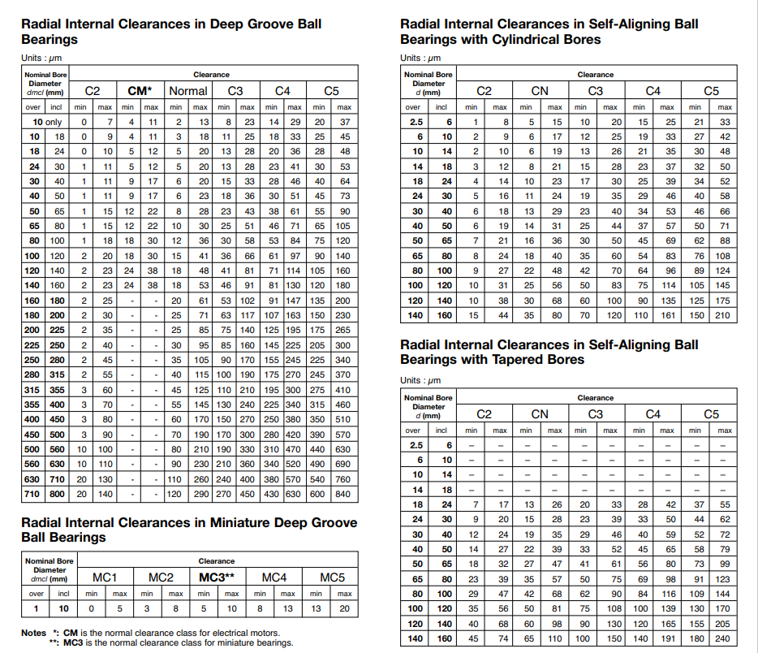

Slide 20
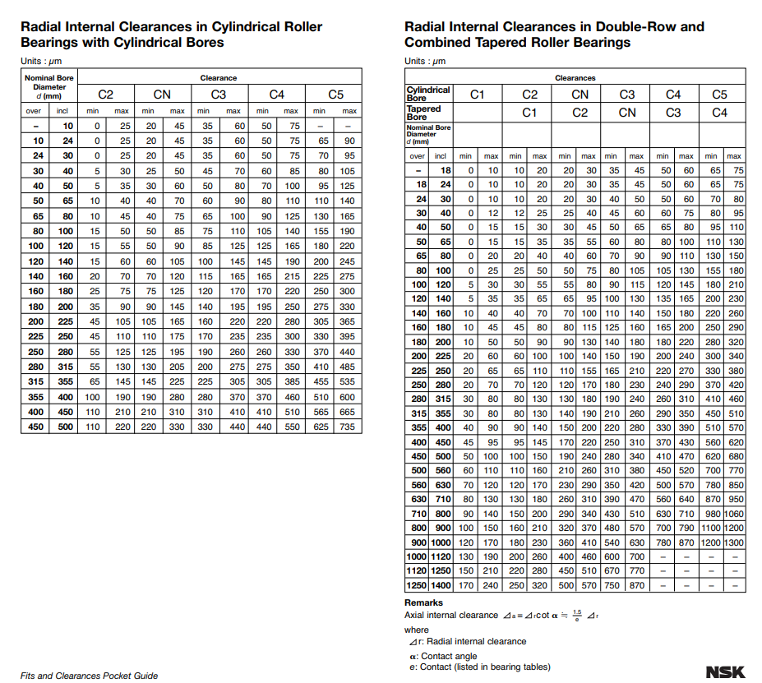

Slide 21
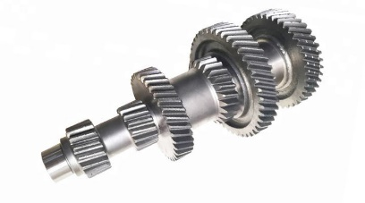
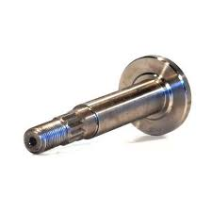
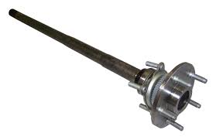
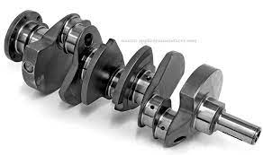
Types of shafts
1.Transmission shaft
This type is used to transmit the power between the power source and the machine, power transmission parts such as pulleys and gears are mounted to this type of shafts.
2.Spindle shaft
Spindle shaft is a rotating shaft, they are usually shorter than other types and used in machines such as lathe machines.
3.Axle shaft
This used to support rotating elements such as these types used in vehicles to support wheels
4.Machine shaft
This type is generally a part of the assembly of the machine such as crankshafts.

Slide 22
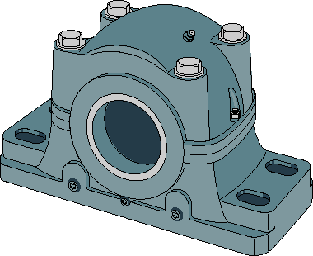
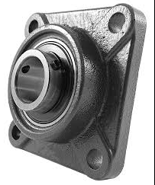
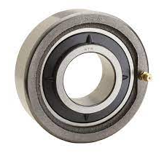
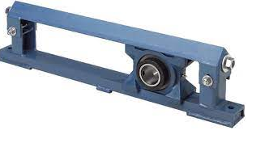
Types of housings
1.Pillow block housing
2.Flanged housing
3.Take up bearing housing
4.Cartridge housing

Slide 23
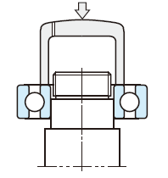
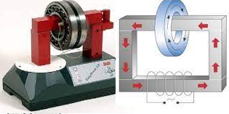
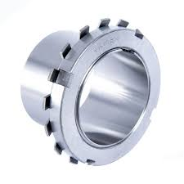
Mounting
1.Press fit
2.Thermal fit
3.Locking devices

Slide 24
Lubrication
lubrication is one of the most important factors determining bearing performance. The suitability of the lubricant and lubrication method have a dominant influence on bearing life.
Functions of lubrication :
To lubricate each part of the bearing, and to reduce friction and wear
To carry away heat generated inside bearing due to friction and other causes
To cover rolling contact surface with the proper oil film in order to prolong bearing fatigue life
To prevent corrosion and contamination by dirt

Slide 25
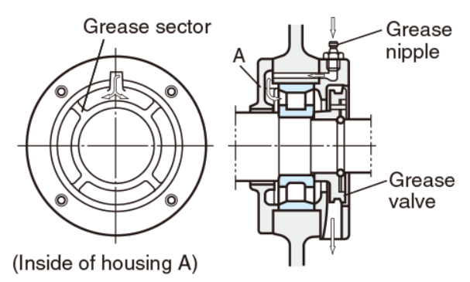
Lubrication
Bearing lubrication is classified broadly into two categories:
grease lubrication
oil lubrication
Grease lubrication
Amount of grease
Replenishment/replacement of grease
Grease feeding interval
Grease life in shielded/sealed ball bearing

Slide 26
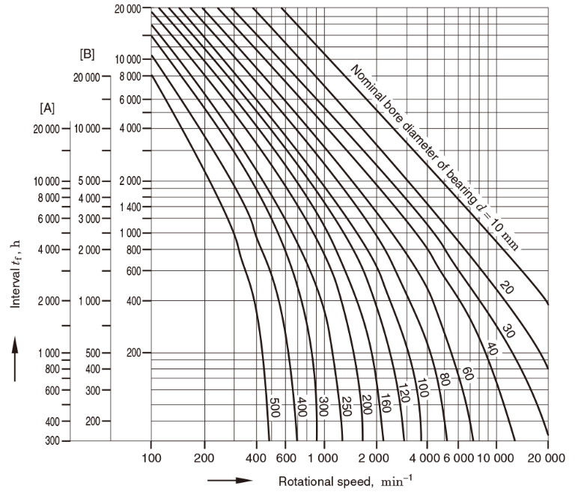
Lubrication
A:radial ball bearing
B:cylindrical roller bearing C:tapered roller bearing, spherical roller bearing

Slide 27
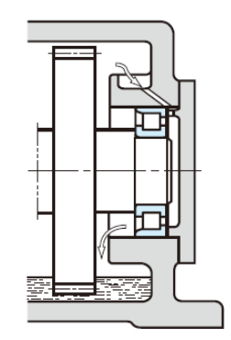
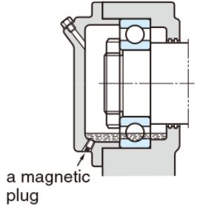
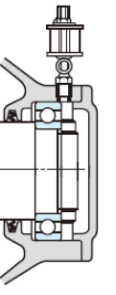
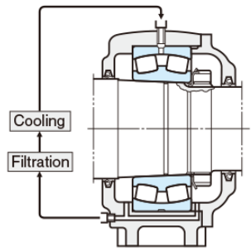
Oil lubrication
Oil bath
Oil drip
Oil splash
Forced oil
circulation

Slide 28
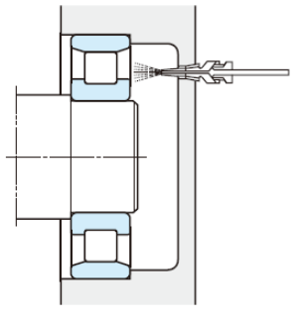
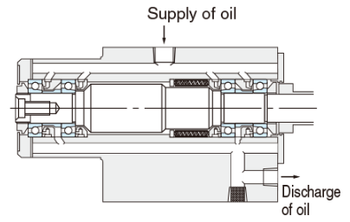
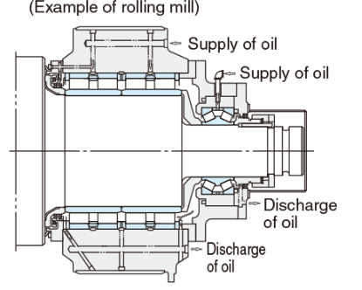
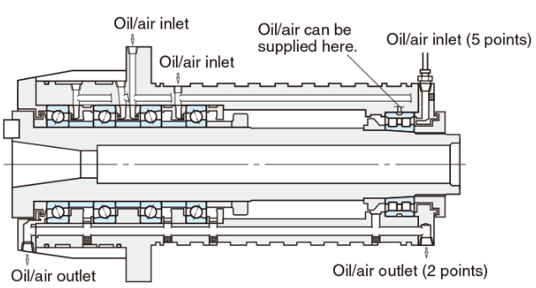
Oil lubrication
Oil jet lubrication
Oil mist lubrication
(spray lubrication)
Oil/air lubrication

Slide 29
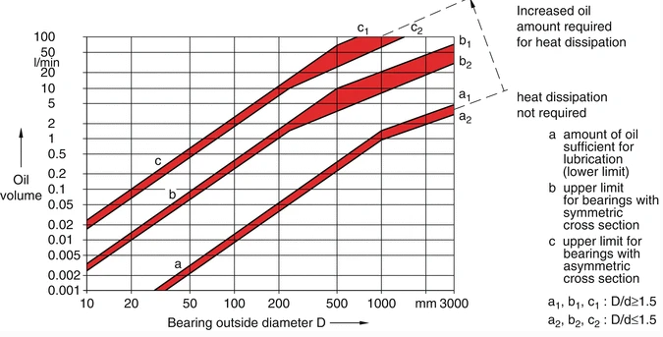
Lubricant for cylindrical roller bearing
Grease is the most common type of lubricant used for rolling bearing lubrication today. About 90% of all bearings are lubricated in this manner.
It is important to select the right grease for specific requirements and to calculate the lubricant life cycle.
In spite of frequent application of grease lubrication for rolling bearings, in many cases oil is used.

Slide 30
Lubrication in our system
Lubricant for self aligning ball bearing:
Mineral oil lubricants are most common type of lubricant used for ball bearing.
These lubricants are made from refined crude oil and are affordable, widely available and effective in reducing friction.
Selection of lubricant depends on :
Function of the lubricant
Practicality and ease of operation
The composition of the lubricant
The lifespan of the lubricant
Cost considerations

Slide 31
Stainless steel bearing
The composition has a lower percentage of carbon than carbon steel bearings and a higher chromium quantity than chrome steel bearings.
stainless steel bearing is highly effective, strong, resistant to corrosion, chemical resistant, softer and temperature flexible than most other bearing types. But need for lubrication
stainless steel bearing can be used in a range of industrial applications including those that are temperature sensitive. Examples include food processing, manufacturing, metal plating, instrumentation, highly chemical areas.

Slide 32
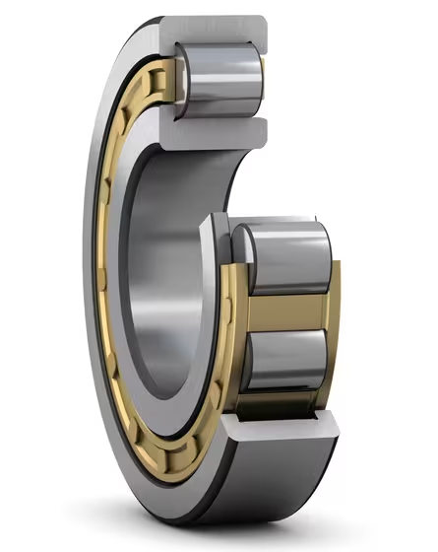
Loads on bearing and vibration on shaft
Bearing types
Cylindrical roller bearings
1. Are separable; this facilitates mounting and dismounting.
2.Can compensate axial tolerances and thermal expansions
3.Precision bearings accommodate high radial loads and speeds

Slide 33
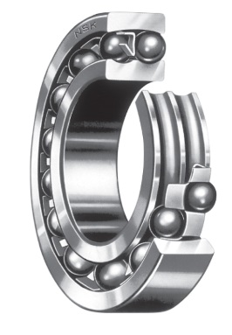
Bearing types
Self aligning ball bearings
1-Compensate for misalignment, shaft deflection and housing deformation.
2-Accommodate radial and thrust loads in both directions.

Slide 34
Vibration
Antifriction bearings are considered as one of the major elements in vibration analysis of a system because
1.Bearings represent a fundamental and basic element that controls the stability and rigidity of a dynamic system.
2.They may be an important source of vibrations.
3.This is why they are considered as a fundamental and crucial feature in a Predictive Maintenance Program of a system.

Slide 35
Cylindrical roller bearings
Self-aligning ball bearing
Decrease the effect of misalignment on the stability of the transmission.
-It is considered as a pivot and hence decrease the rigidity of the system.( increase vibration)
an not withstand the effect of misalignment of the shaft
It is considered as a rigid fixation and hence increase the rigidity of the system(reduce vibration )

Slide 36
Thank You

